Slide 1
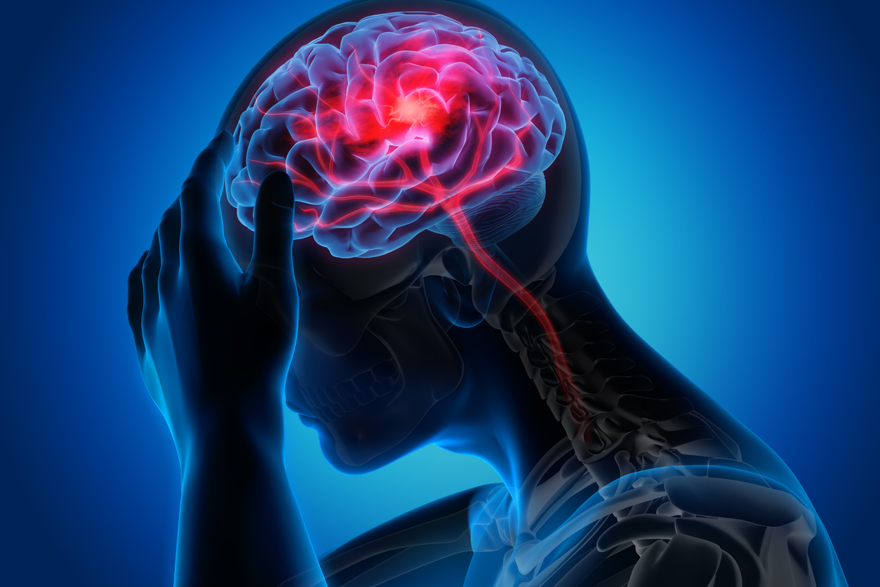
STROKE PREDICTION
By / Mohamed Adel Hosny
Supervisor / Doaa Mahmoud Abdel-Aty
Git hub/ https://github.com/Mohamed-adel-Hosny
Kaggle/ https://www.kaggle.com/mohamedadelhosny
Linkdin/ https://www.linkedin.com/in/mohamed-adel-hosny-692283a3/

Slide 2
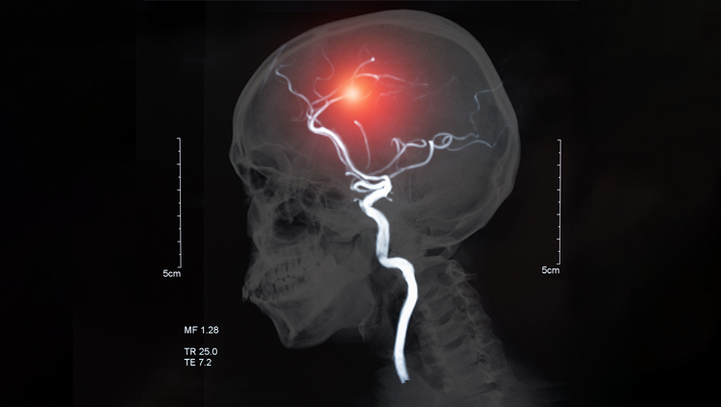
Agenda :
Case of study ( Data – parameters – Goal ).
Libraries used on Data.
Data cleaning and preprocessing.
Exploratory Data.
Modeling selection and accuracy.
Recommendations
Data link in Kaggle :
https://www.kaggle.com/fedesoriano/stroke-prediction-dataset

Slide 3
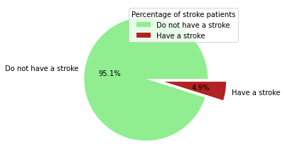
1. Case of study :
The stroke is the 2nd leading cause of death globally.
It responsible for approximately 11% of total deaths.
The data consists of 12 parameter :
ID
Gender
Age
Hypertension
heart disease
ever married
work type
Residence type
avg glucose level
Bmi
smoking status
Stroke
Stroke patients percentage is 4.9% of the Total Data.

Slide 4
2. Libraries used on Data :
Python libraries used in analysis :
Pandas
Numpy
Matplotlib
seaborn
Sklearn
Imblearn

Slide 5
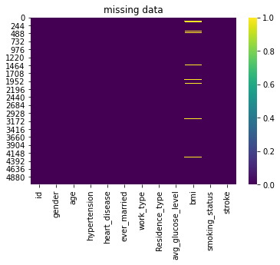
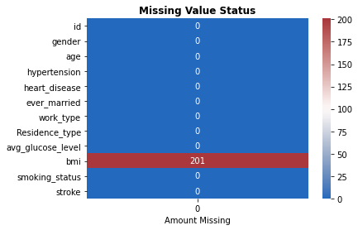
3. Data cleaning and preprocessing :
Missing Value are 3.9% of the data.
All NaN values exist in BMI parameter
( 201 values ) .

Slide 6
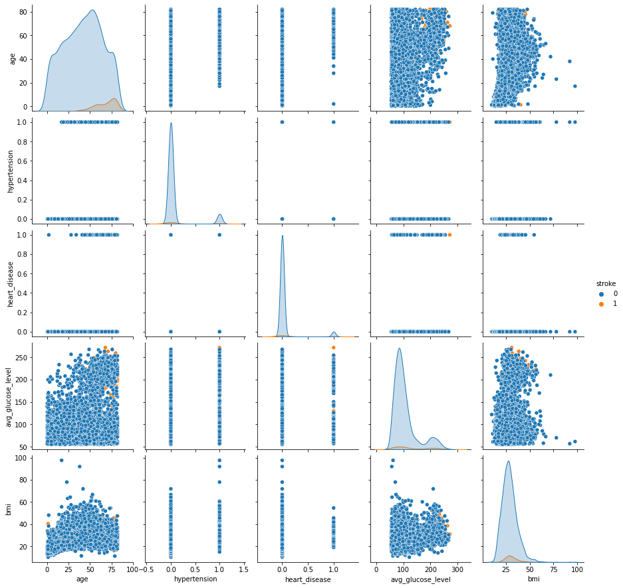
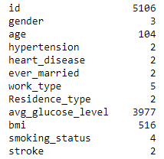
3. Data cleaning and preprocessing :
No. of unique values in Data for each parameters.
Most of the data is classified into categories type with two or more category.

Slide 7
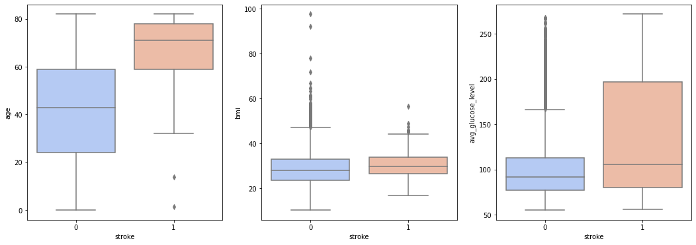
3. Data cleaning and preprocessing :
There is 4 readings outliers in BMI (Body Mass Index).
As number of outliers is very small, we can drop it.

Slide 8
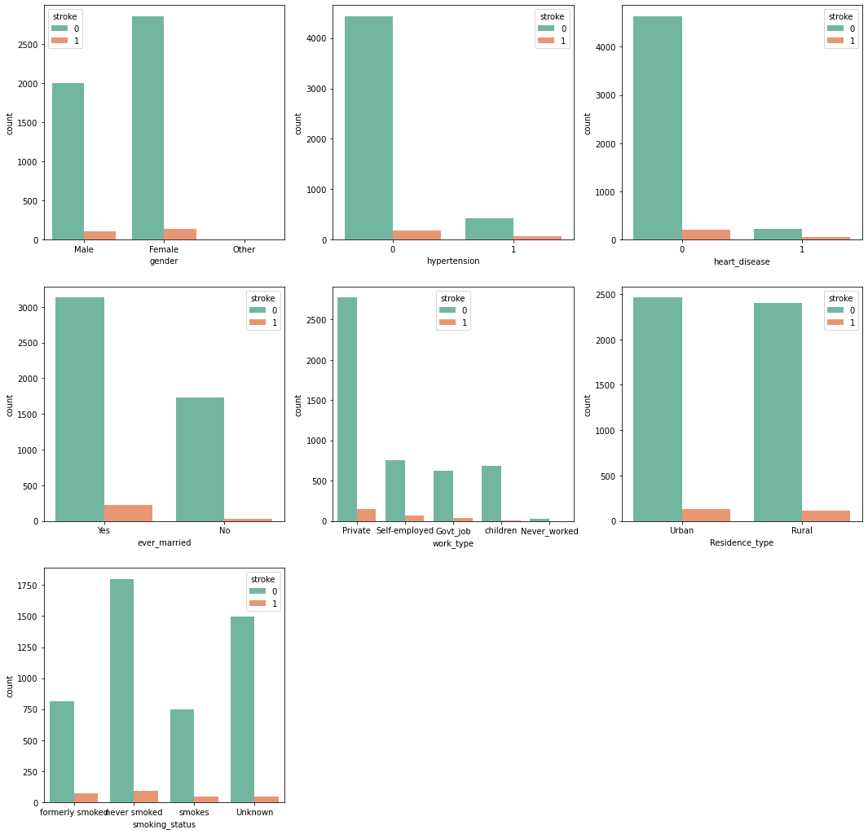
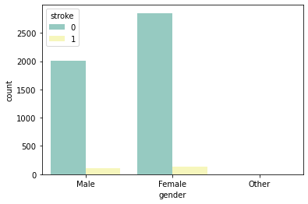
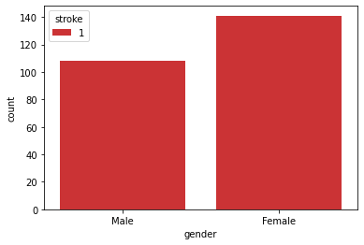
4. Exploratory Data :
Gender
Gender has no interference to can predict the probability for person to get a stroke or not.

Slide 9
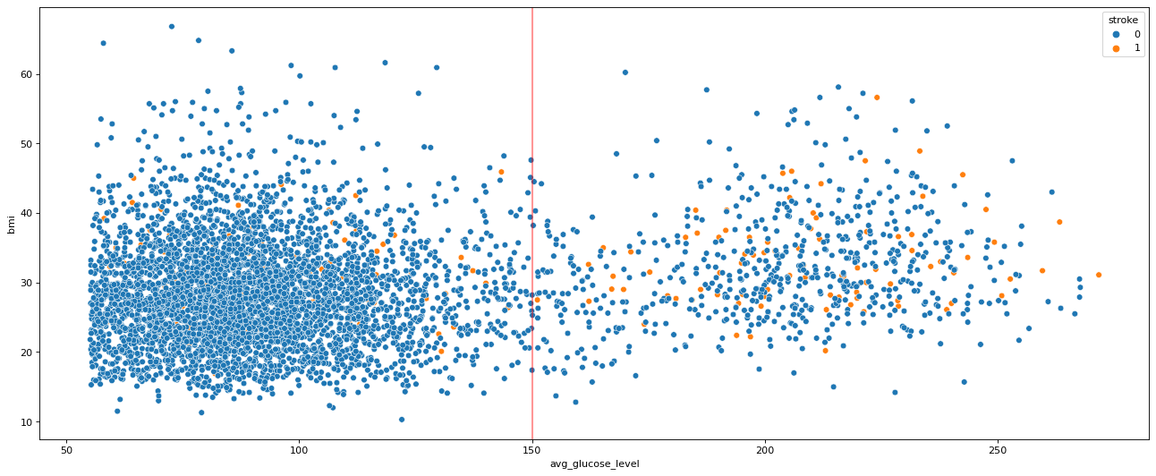
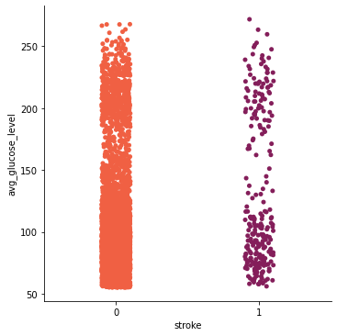
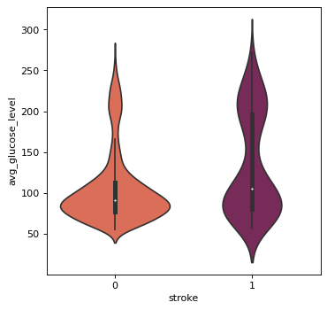
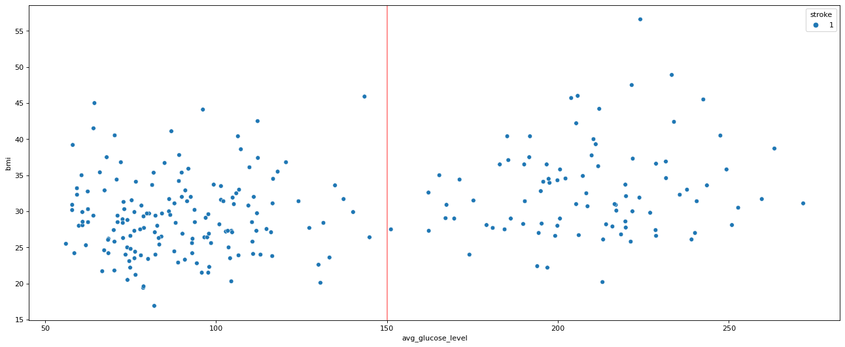
4. Exploratory Data :
Avg Glucose Level
The data can be split into two category :
( Normal patient and Diabetes patients )

Slide 10
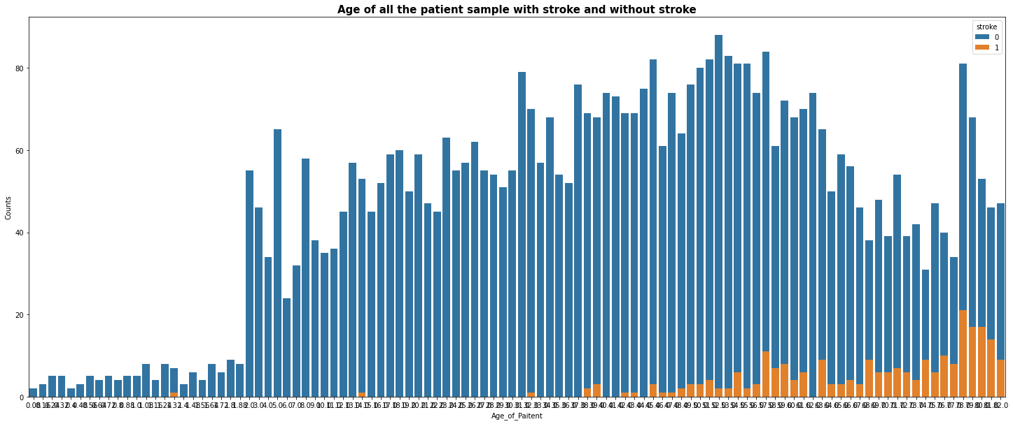
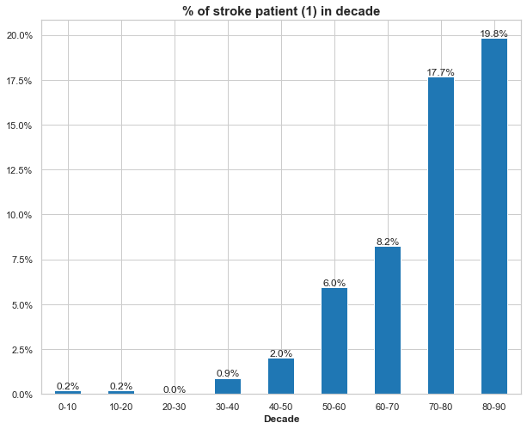
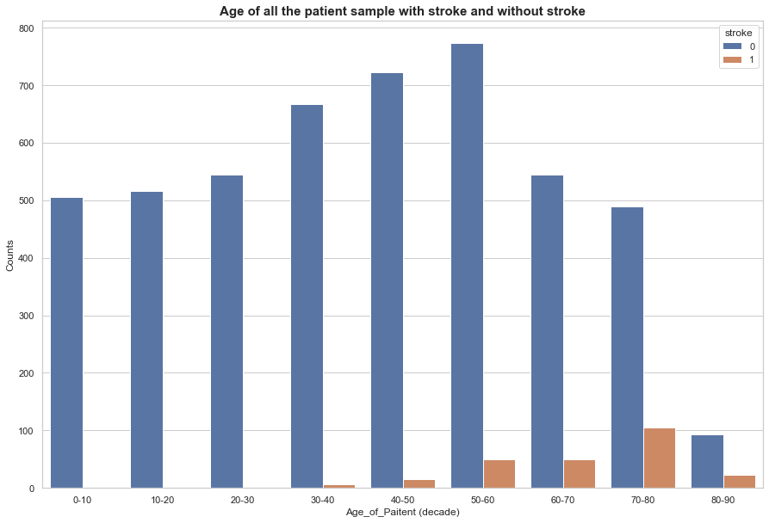
4. Exploratory Data :
Age
Recommendation for people with age more than 70-90 to check up with a doctor.

Slide 11
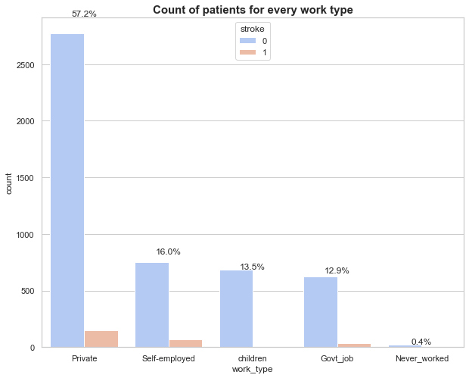
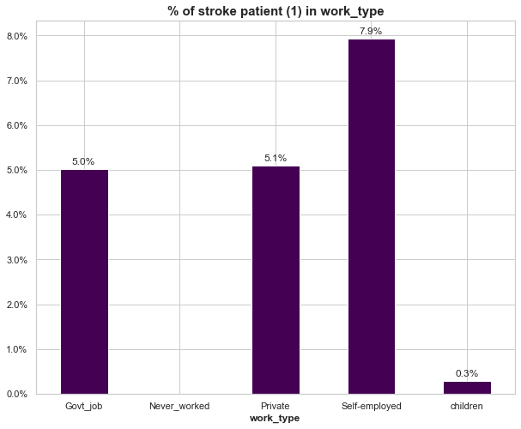
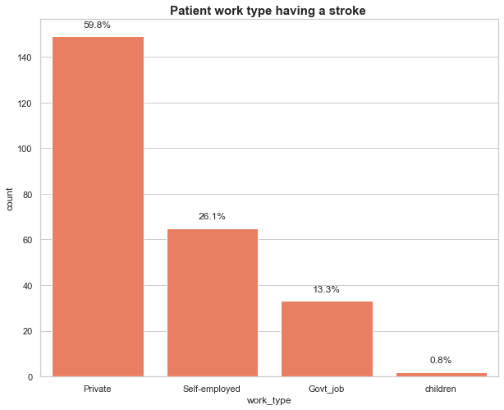
4. Exploratory Data :
Work type
Self employment job have the most effect on people to get a stroke.

Slide 12
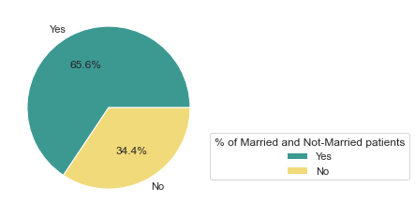
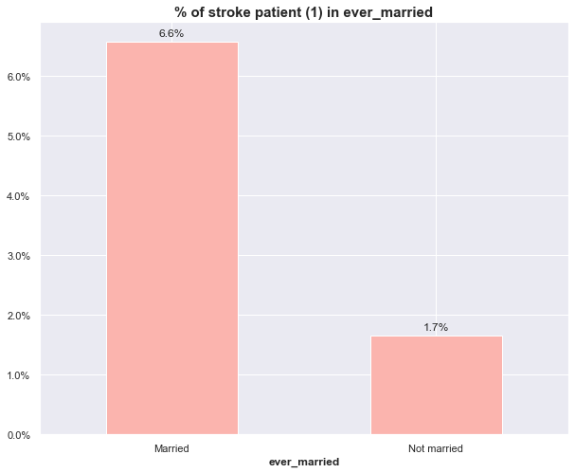
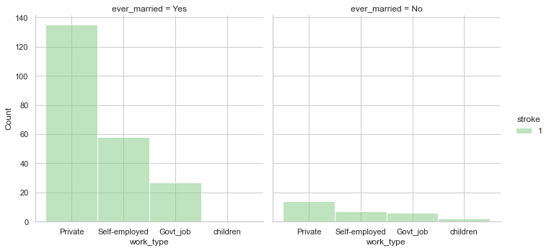
4. Exploratory Data :
Ever Married
The most of people get a stroke are the married one.

Slide 13
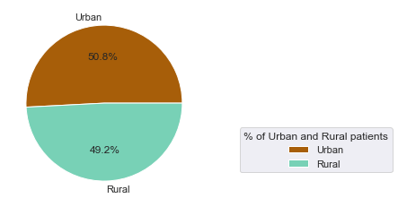
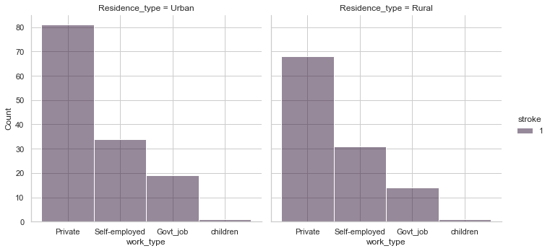
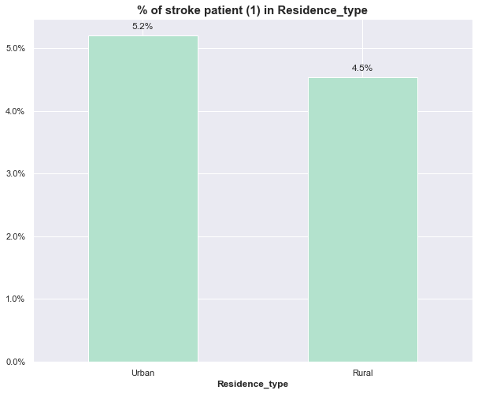
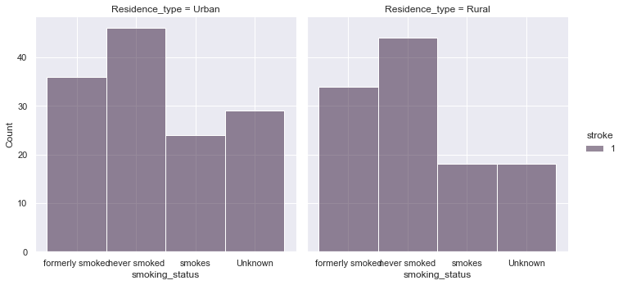
4. Exploratory Data :
Residence type
The Residence type not affects the reasons to get stroke.

Slide 14
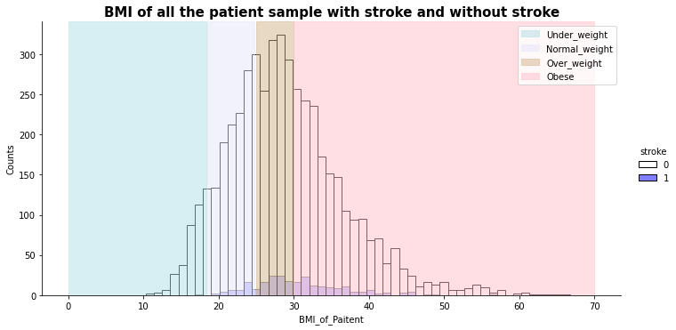
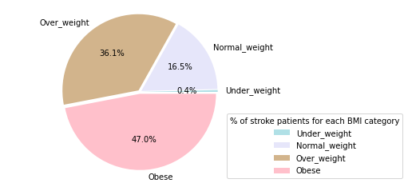
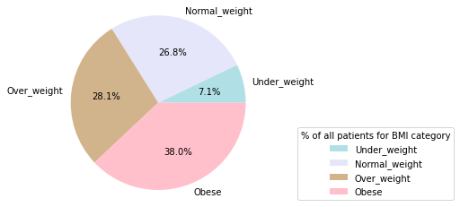
4. Exploratory Data :
BMI (Body Mass Index)
The data can be split into four category :
[ Under_weight - Normal_weight - Over_weight - Obese ]

Slide 15
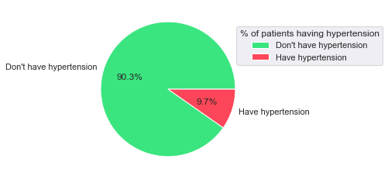
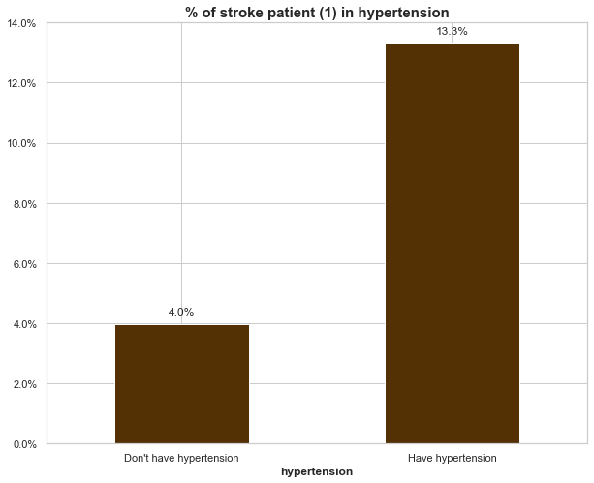
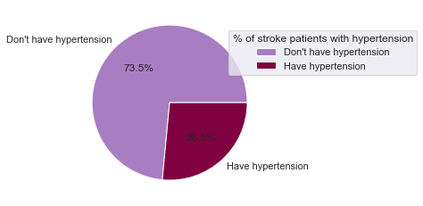
4. Exploratory Data :
Hypertension
Most of stroke patients are who have a hypertension.

Slide 16
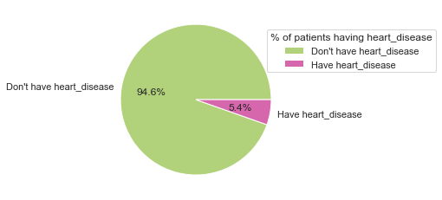
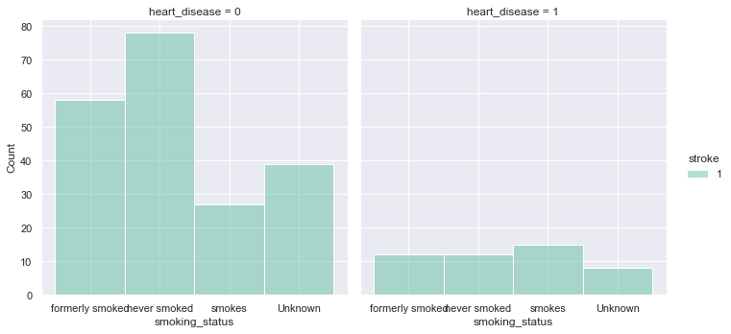
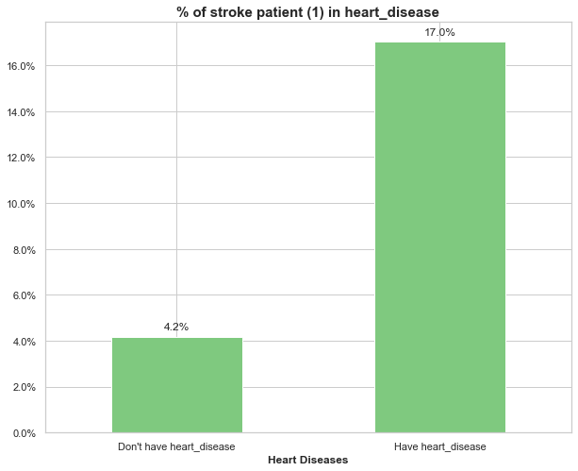
4. Exploratory Data :
Heart Disease
Patient with heart disease have to quit smoking as they are most likely to have a stroke.

Slide 17
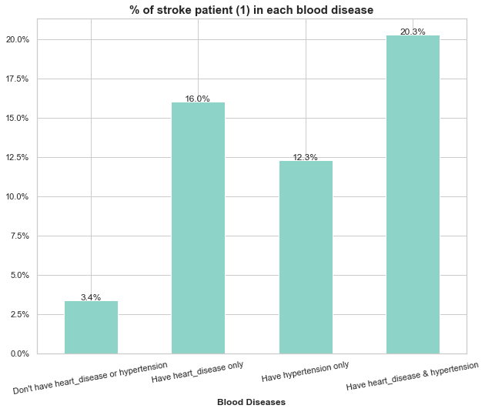
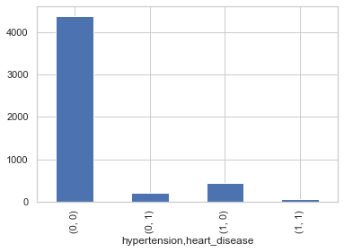
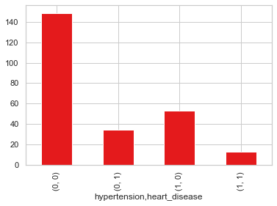
4. Exploratory Data :
Heart Disease & Hypertension
People who has hypertension and heart diseases
are the most to get stroke.

Slide 18
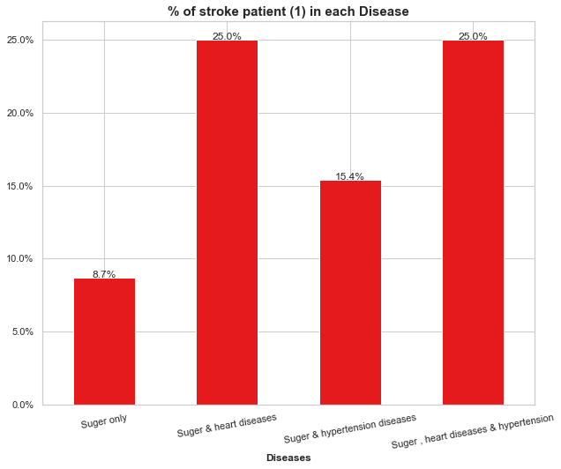
4. Exploratory Data :
Heart Disease & Hypertension
with Diabetes patients
Patients with Diabetes and heart diseases are
the most probably to get a stroke.

Slide 19
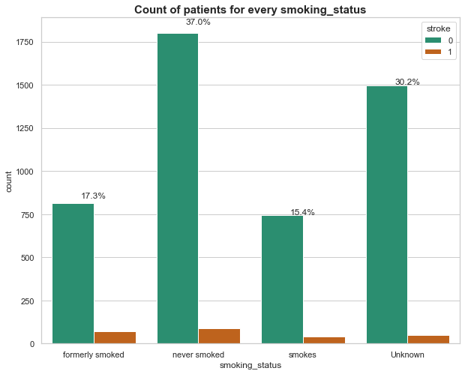
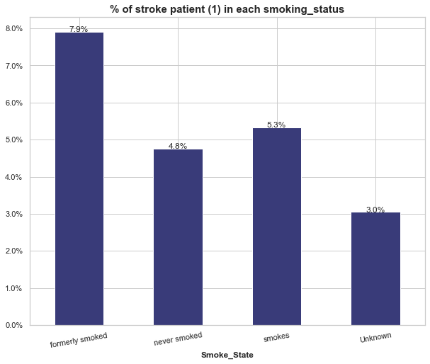
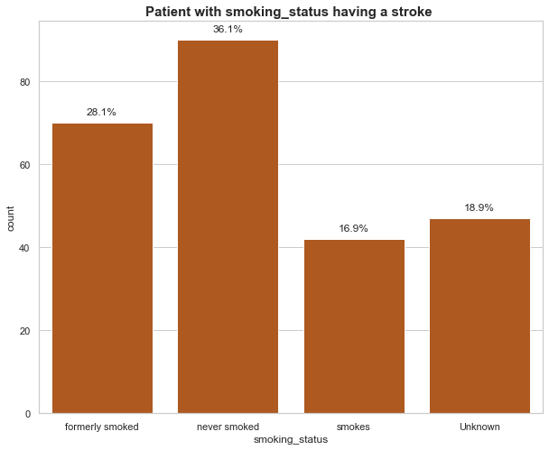
4. Exploratory Data :
Smoking state
The smoking people who have quite smoking or still smoking are more probably to get stroke than who don't never smoked.

Slide 20
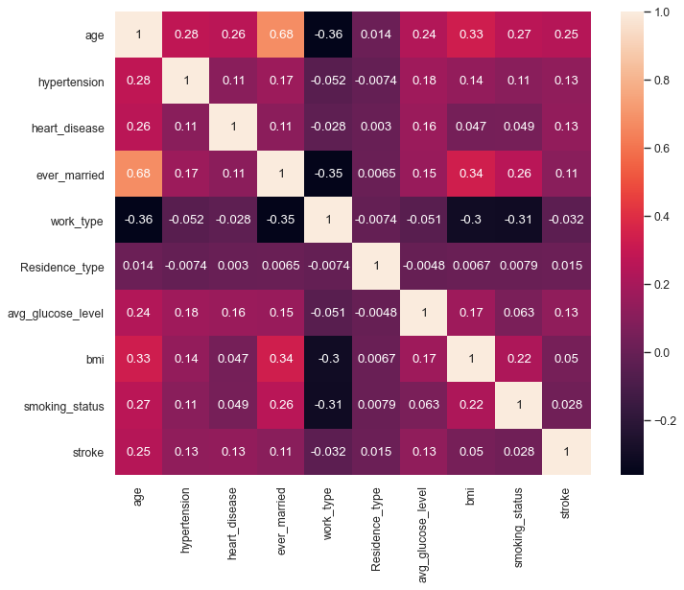
5. Modeling selection and accuracy :
Feature Selection
Linear correlation between features
and target prediction value is very low.
ID & gender features are not effecting the
probability of patients to have a stroke,
So they eliminated from selection.

Slide 21
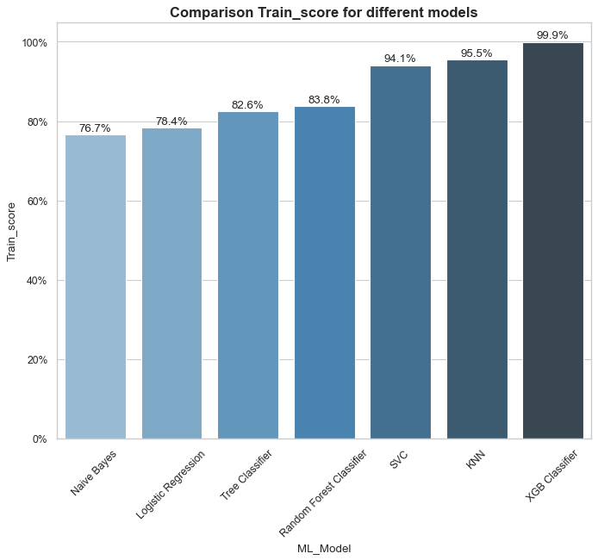
5. Modeling selection and accuracy :
Model Selection
Different model have been tested with Data
as showing in the graph the accuracy
for XGB classifier model is the best
accuracy ( 99.9% ) .
KNN model and SVC have also good accuracy.

Slide 22
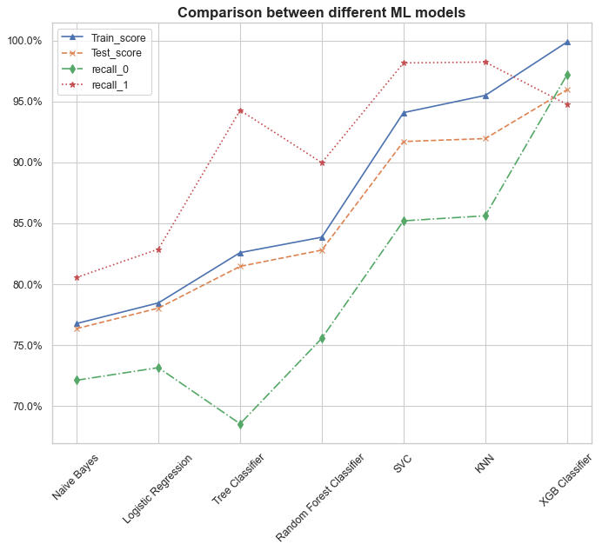
5. Modeling selection and accuracy :
Model Selection
Recall for XGB classifier is good beside
the score of train and test data which make
best model to select is XGB Classifier.

Slide 23
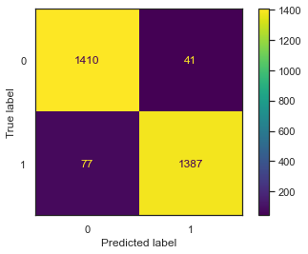
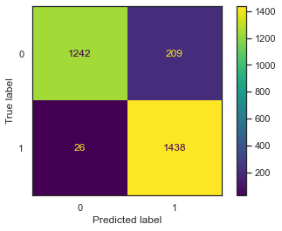

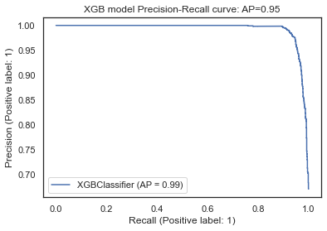


5. Modeling selection and accuracy :
XGB Classifier
KNN classifier
SVC

Slide 24

5. Modeling selection and accuracy :
XGB Classifier
The Feature Importance represents
Three category for importance :
Strong effect
(age – work state
– smoking state )
Moderate effect
(hypertension – heart disease
– ever married)
Weak effect
(Residence type – BMI
– avg. glucose level )

Slide 25

6. Recommendations :
If you work as self employed, try to make a frequent medical check up for any of heart disease or hypertension.
The smoking people who have quite smoking or still smoking are more probably to get stroke than who don't never smoked.
People with Overweight need to try health food and daily exercises.
Patient with heart disease have to quit smoking as they are most likely to have a stroke.
People over age of 70 with heart disease need a special care as they are most probable to have a stroke.
If you feel of weakness in your face or arm and have a speech problems, go immediately to nearest hospital for medical care.

Slide 26

Thank You
Tele: 01118669802
Mail: m_adel_hosny@hotmail.com
3/8/2021

